Slide 1
Introduction to KiCAD
PCB Design & Development
J.C. Vaught, 02-17-2024

Slide 2
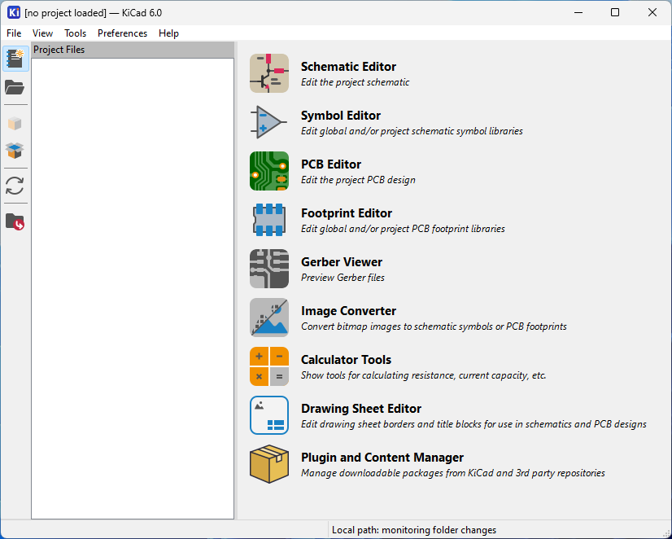
Open KiCAD.
Once KiCAD is open, click on the “New Project” Icon

Slide 3
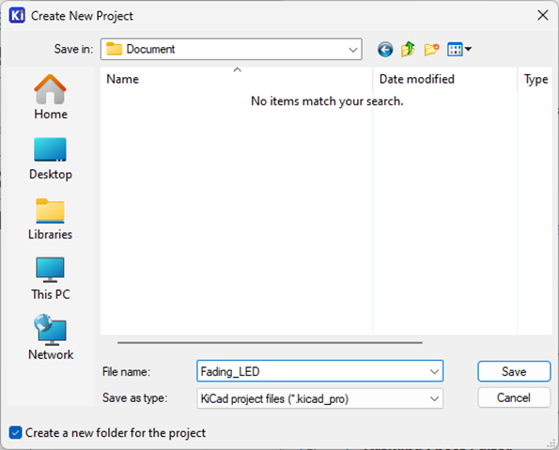
Name the Project Fading_LED.
You may save it in your Documents folder as shown here.

Slide 4
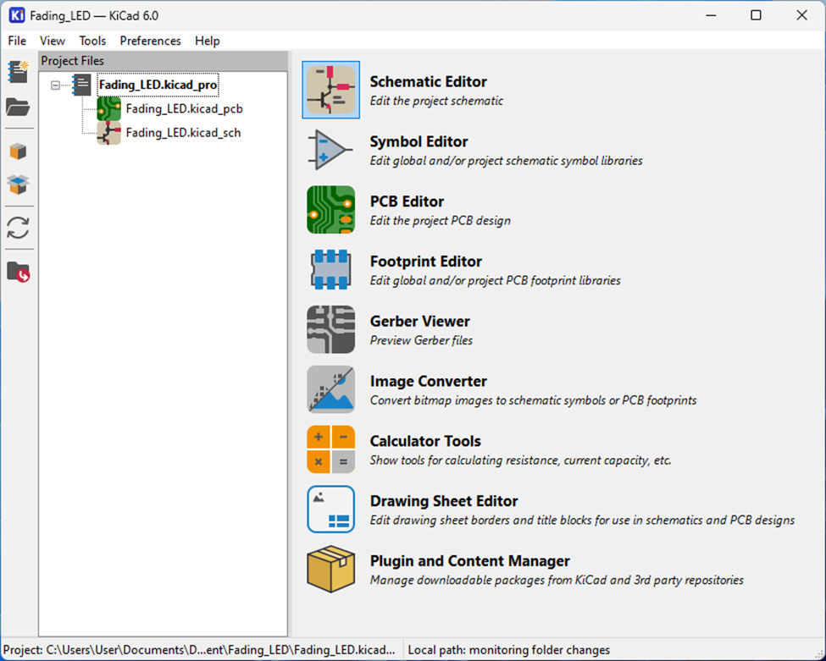
Once Project is created, you will see multiple files.
Click on the “Schematic Editor” to begin building our circuit schematic

Slide 5
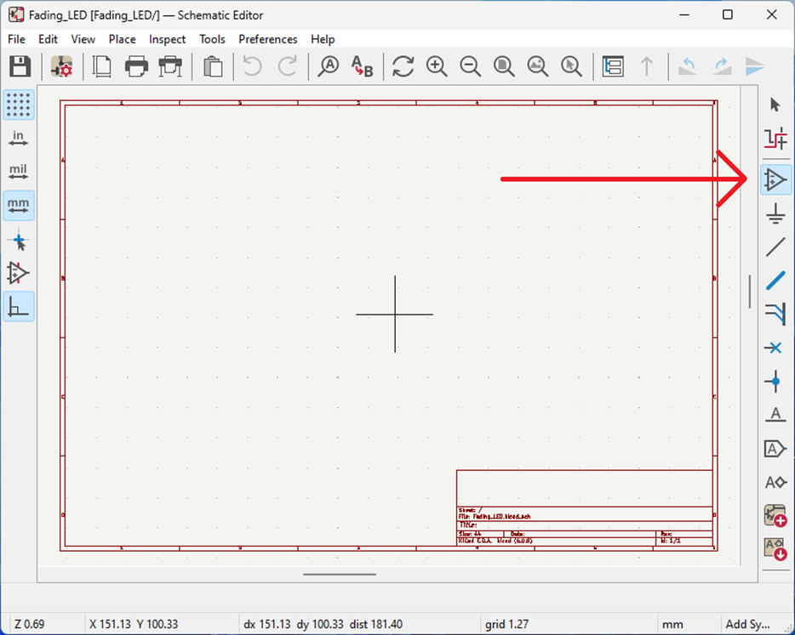
Once the Schematic Editor Window is opened, click on the “Place Symbol” Icon in the righthand Toolbar
This places different electrical components on the schematic

Slide 6
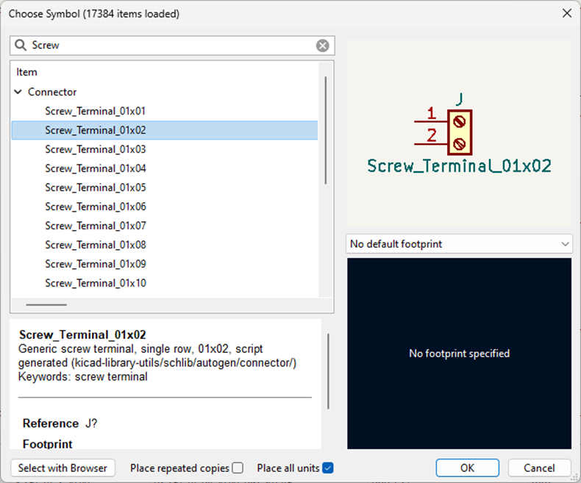
Once the Choose Symbol Dialog Window is opened, select/search the component you want to add.
Then you will place them onto the schematic window.
You will do this for each of the following components:
‘Screw_terminal_01x02’
‘R’ (do this twice) (Resistor)
‘C’ (Capacitor)
‘LED’
‘GND’ (Ground)

Slide 7
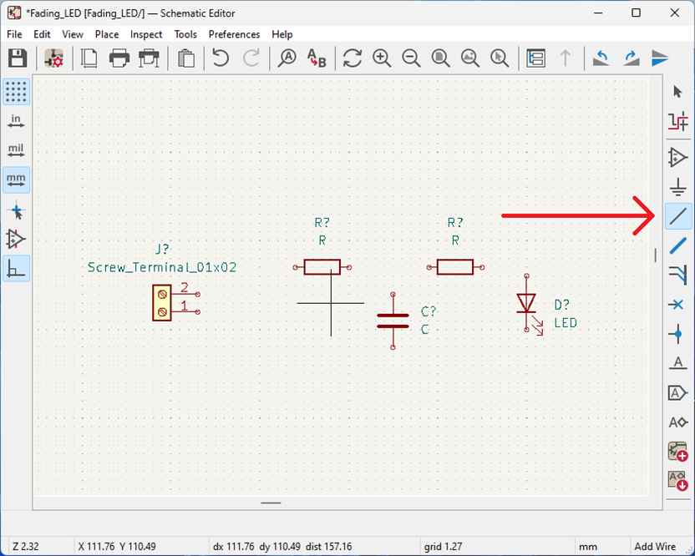
Once all Components are placed, click on the wire icon and connect wires between all the components, as shown in Slide 10.
Press R on the keyboard to rotate components.
Note: This image is missing the Ground component.

Slide 8
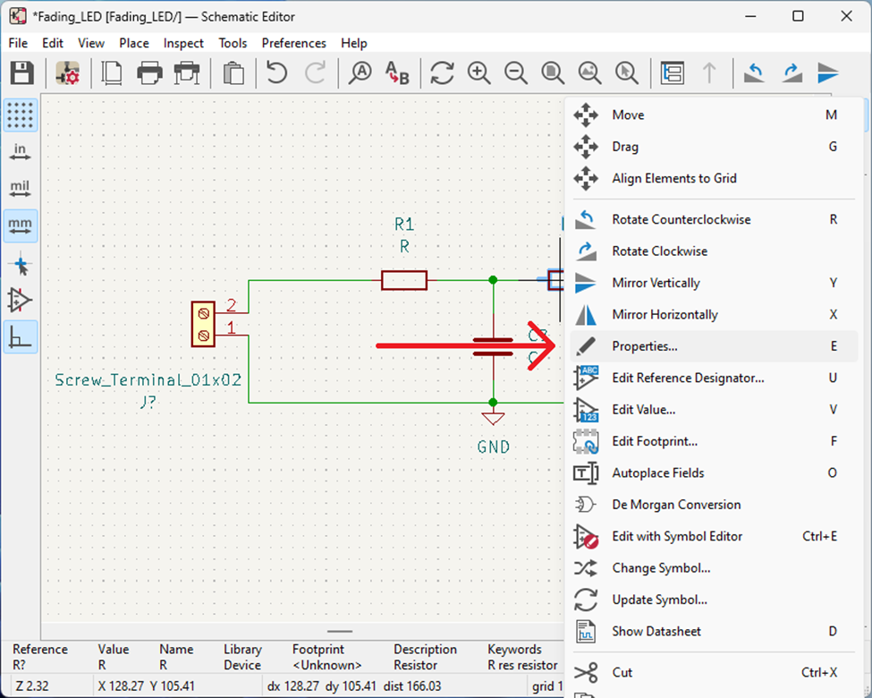
Once all components are wired, we need to give each of the components/symbols a name.
Right click on each component, click Properties, and give them a name

Slide 9
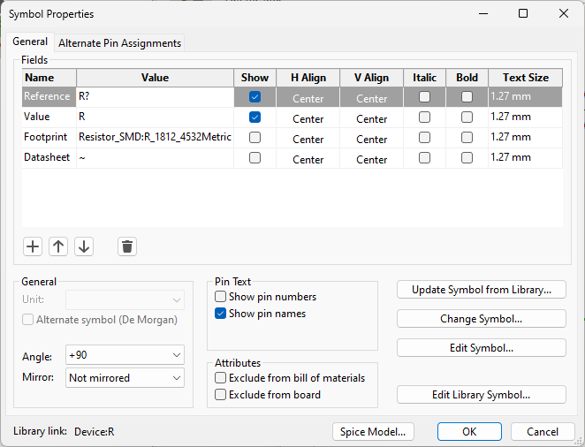
Name all the components as follows:
Block Terminal: J1
LED: D1
Resistor: R1 & R2
Capacitor: C1
Ground: #PWR01

Slide 10
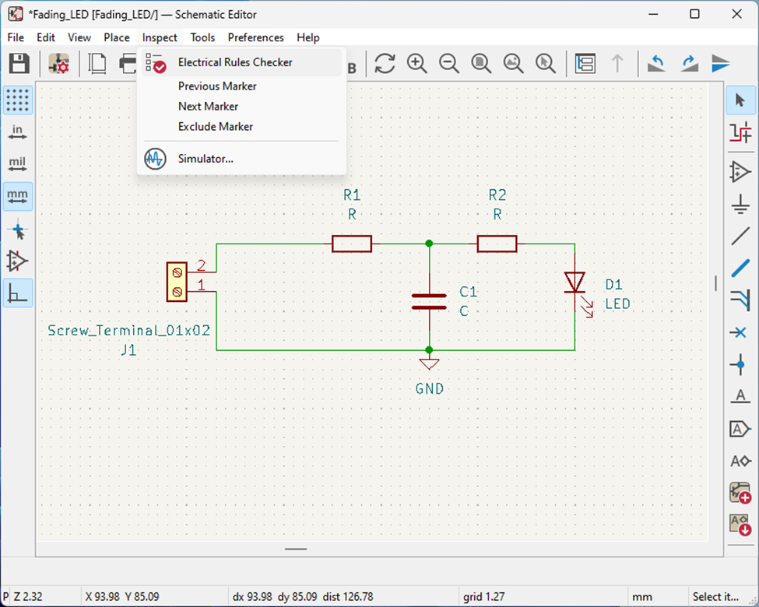
Now that the schematic is complete, we will run the Electrical Rules Checker to detect any errors.

Slide 11
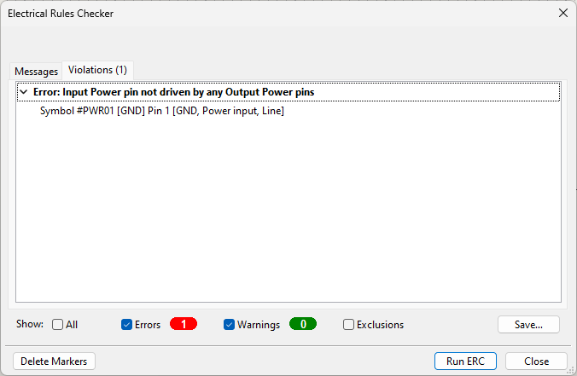
One the Electrical rules Checker is complete, there should be ONE error, indicating no power supply.
This is alright, since we will connect power to the terminals of the block terminal.

Slide 12
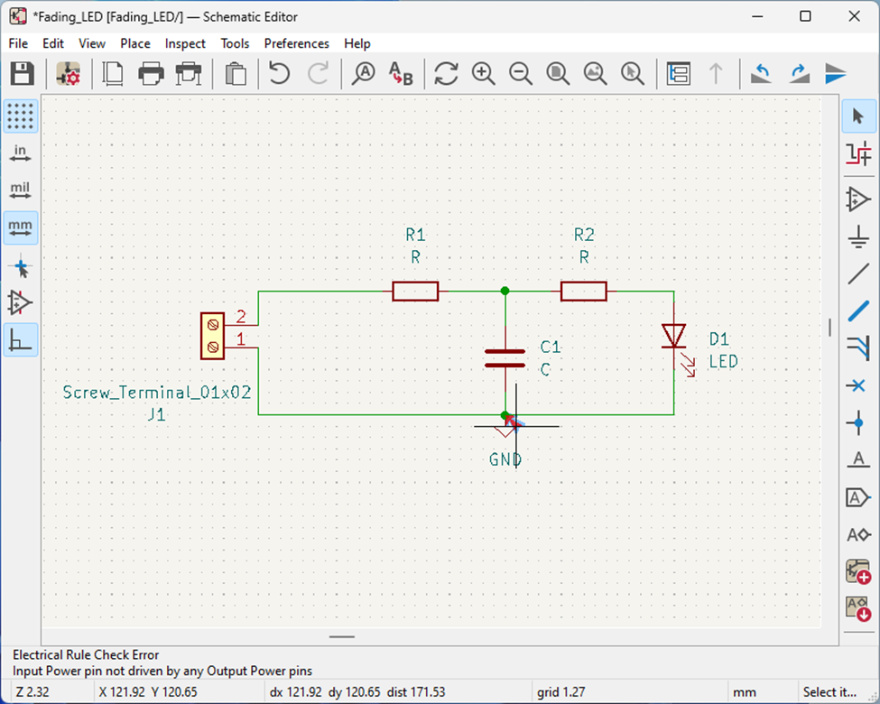
Note that the Electrical Error Software will identify what it thinks the issue is:

Slide 13
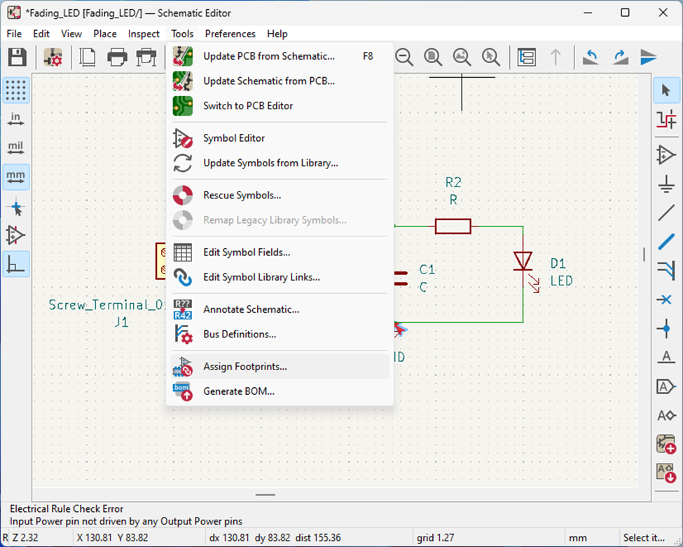
Once the checker step is complete, we can assign footprints to the components
Because there are different physical sizes of components, we select the physical “footprint” of the component for the PCB

Slide 14
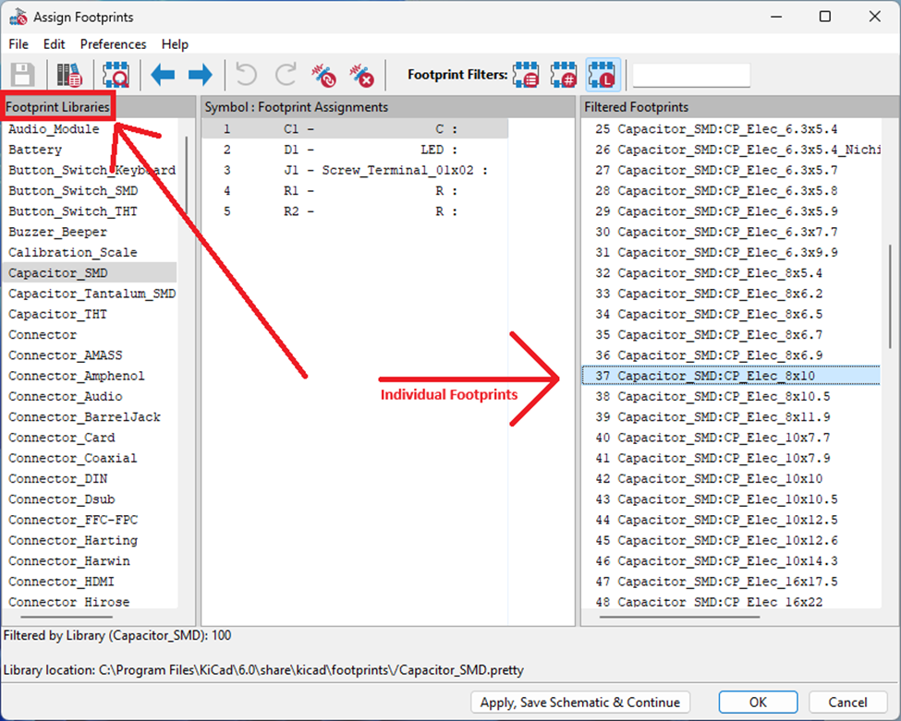
To select components, we first select the “library” the component is in from the lefthand pane.
Then we select the desired footprint from the library in the righthand pane
Components are below:
 | Library | Footprint
C1 | Capacitor_SMD | CP_Elec_8x10
D1 | LED_THT | LED_D3.0mm
J1 | TerminalBlock_Phoenix | TerminalBlock_Phoenix_MKDS-1, 5-2-5.08_1x02_P5.08mm_Horizontal
R1 | Resistor_SMD | R_1812_4532Metric
R2 | Resistor_SMD | R_1812_4532Metric

Slide 15
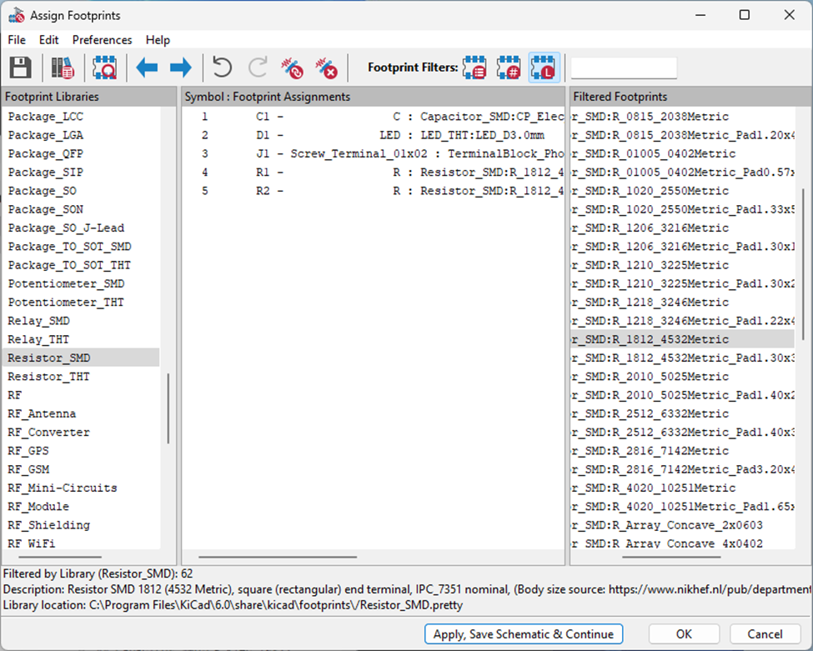
To apply a footprint to the component, double click the footprint in the righthand pane.
The image depicts the final page of the footprints once everything is assigned.

Slide 16
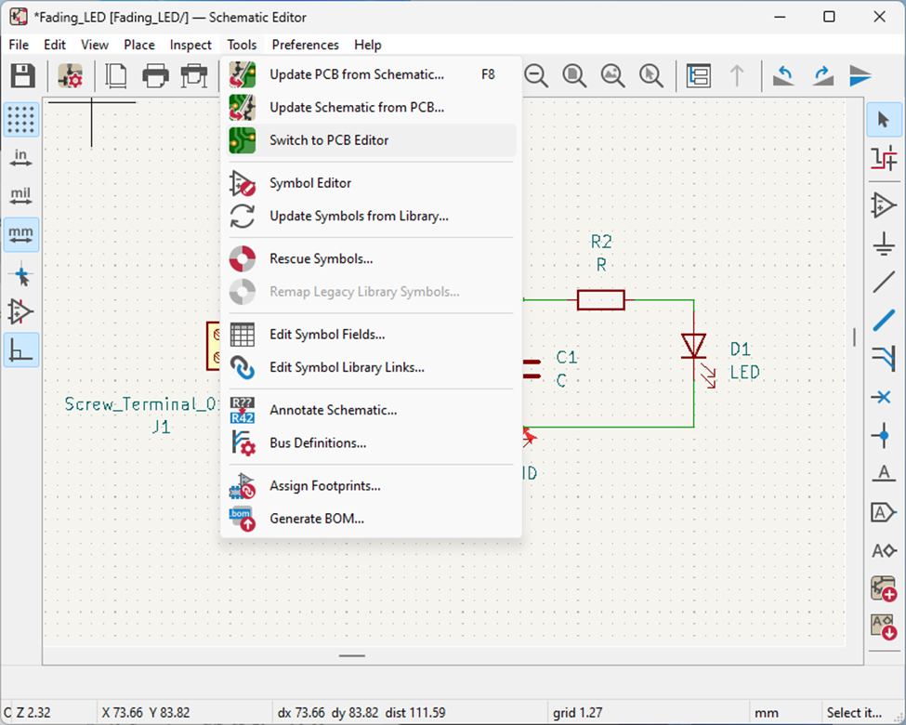
Once Footprint assignment is complete, we can switch to the PCB Editor View

Slide 17
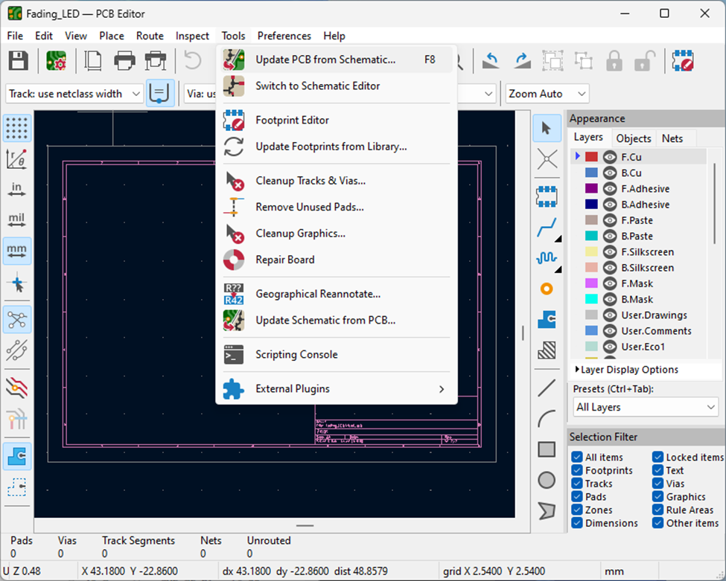
Once in PCB Editor View, we need to import the schematic
Click on the Update PCB from Schemtic icon in the Tools dropdown.

Slide 18
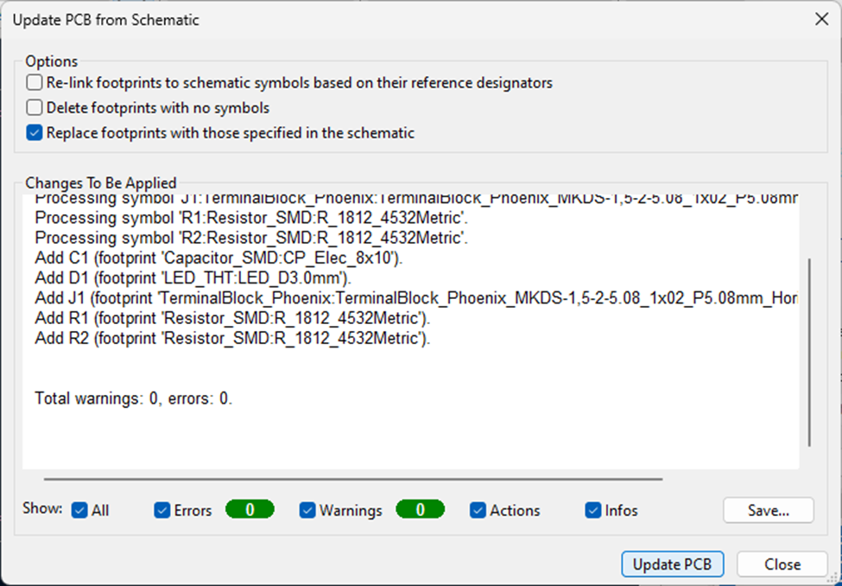
Click on Update PCB, then Close the dialog window

Slide 19
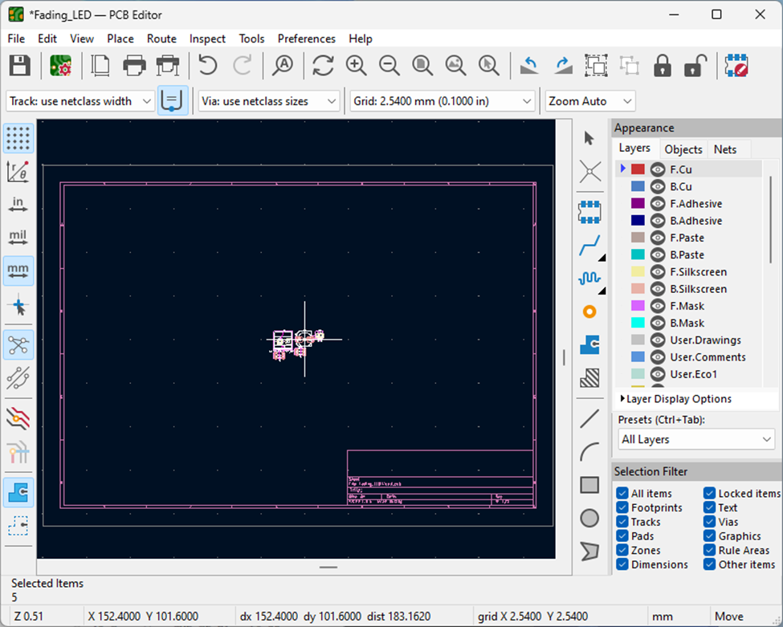
You should see a small footprint appear on the screen.
Try to place it centered on the page as shown here.

Slide 20
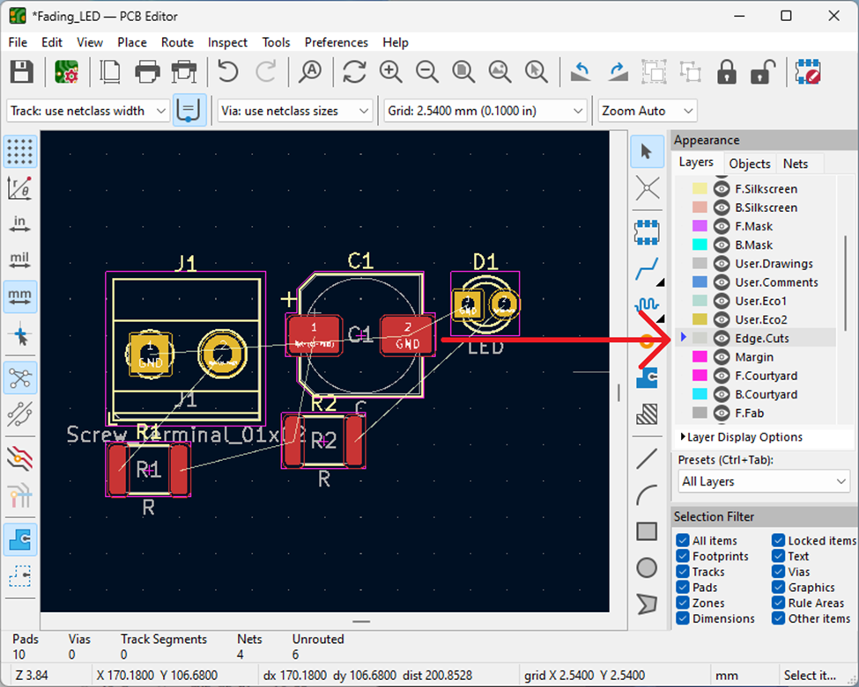
Now we need to draw the outline of the actual PCB Board.
Select Edge.Cuts so we can define where the edge of the PCB is
This image is zoomed in to show the footprints more clearly.

Slide 21
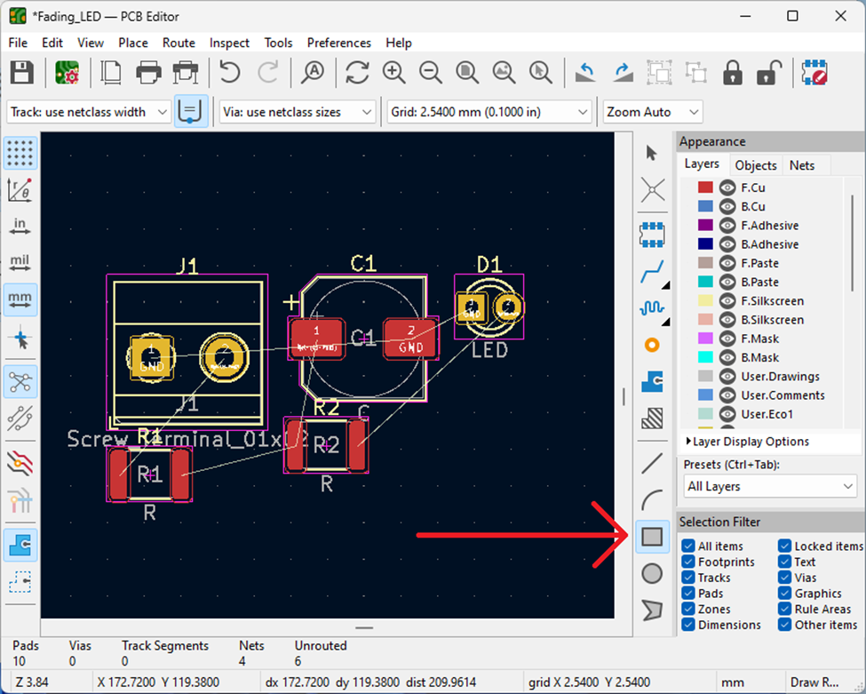
Select the rectangle drawing tool and draw a 25.4mm by 25.4 mm rectangle.
The components will NOT be aligned to the circuit, but we will fix that next.
Note: Do NOT press and hold for the drawing tool. Press and release for the first corner, and do the same for the opposite corner

Slide 22
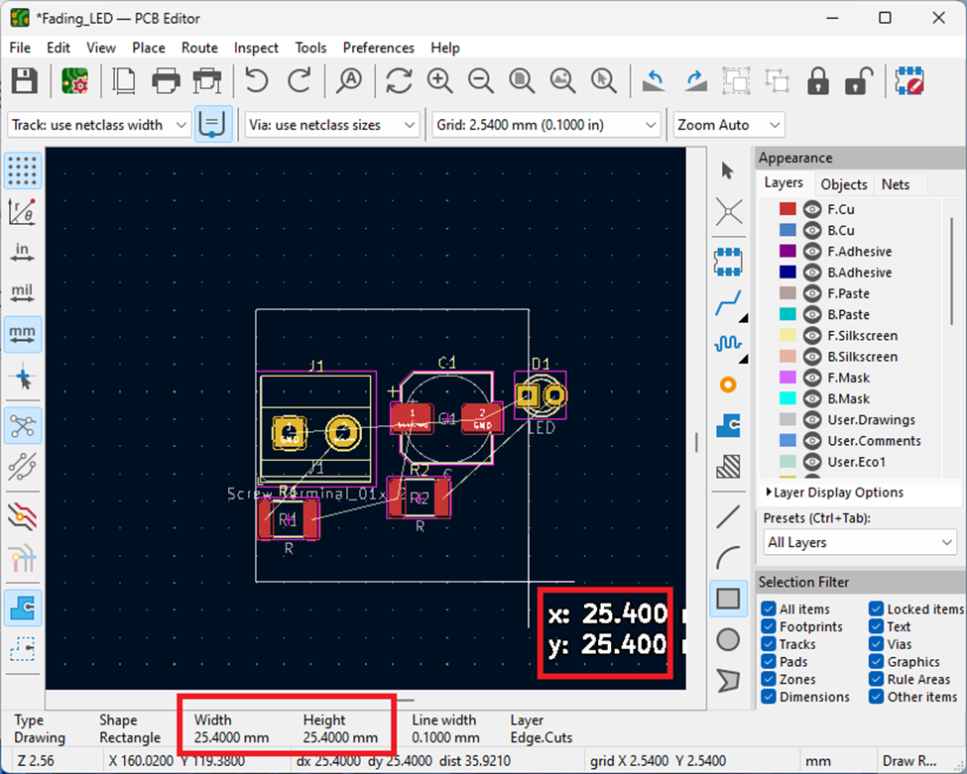
This is an example of what Your rectangle could look like.
Note that the dimensions of the rectangle drawn are shown in multiple locations.

Slide 23
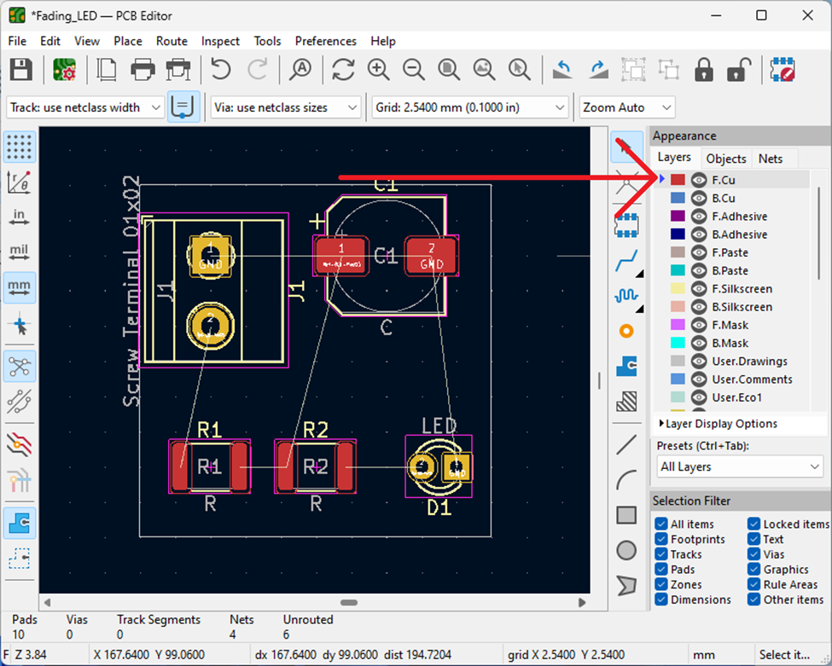
Now you need to rearrange the footprints of the components so they fit on the rectangle you just drew.
Try to minimize lines crossing, since each crossing indicates another layer for the PCB (More COST!)
Once finished with rearranging components, select the F.Cu layer to edit
Press R to rotate components

Slide 24
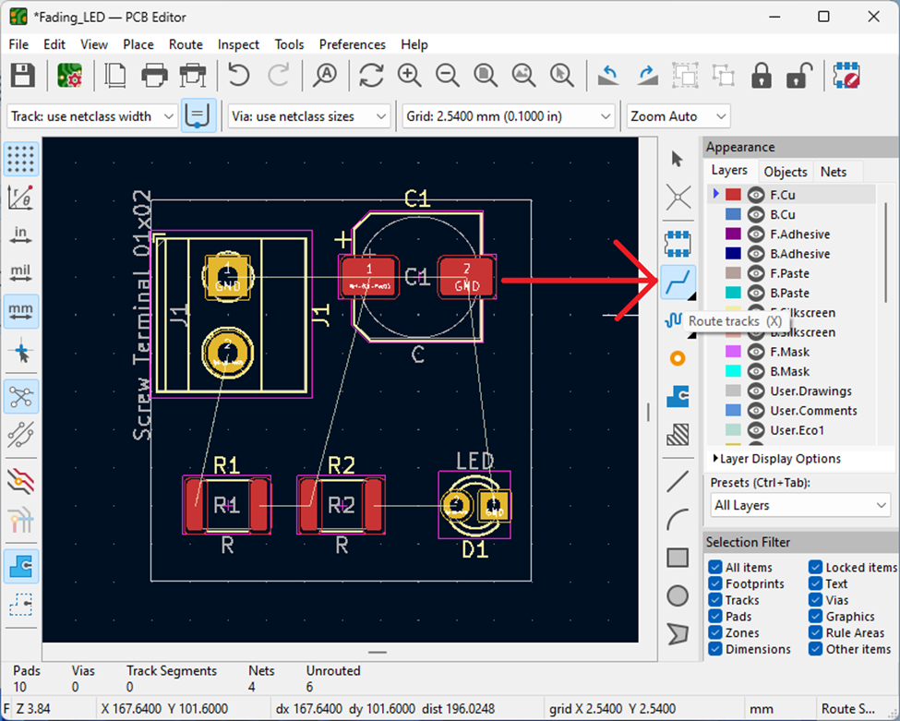
Once all components are placed, and the F.Cu layer is selected, we can draw the traces between the components.
Click on the Trace icon in the righthand pane to begin drawing traces.

Slide 25
Once all components are placed, and the F.Cu layer is selected, we can draw the traces between the components.
Click on the Trace icon in the righthand pane to begin drawing traces.
Do NOT connect any of the Ground/GND traces. They will connect to a ground layer on the opposite side of the PCB.

Slide 26
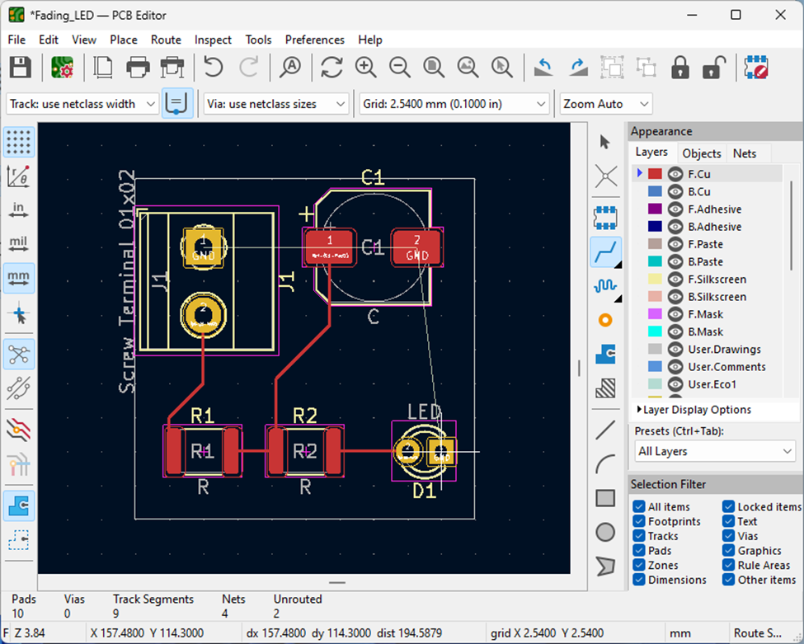
This is an example of what your final traces could look like.
Note that the GND connections are not connected.

Slide 27
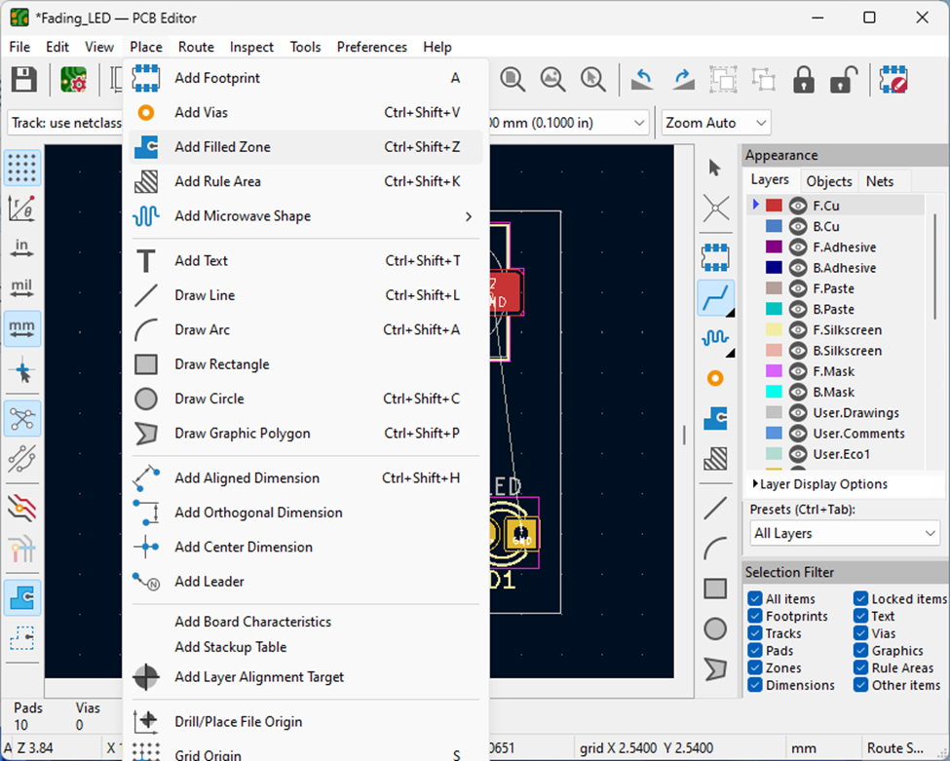
Now we need to complete the Ground Layer.
Since most components are SMD in this layout, the ground plane will also be F.Cu
Begin by clicking on Add Filled zone under the Place Dropdown menu

Slide 28
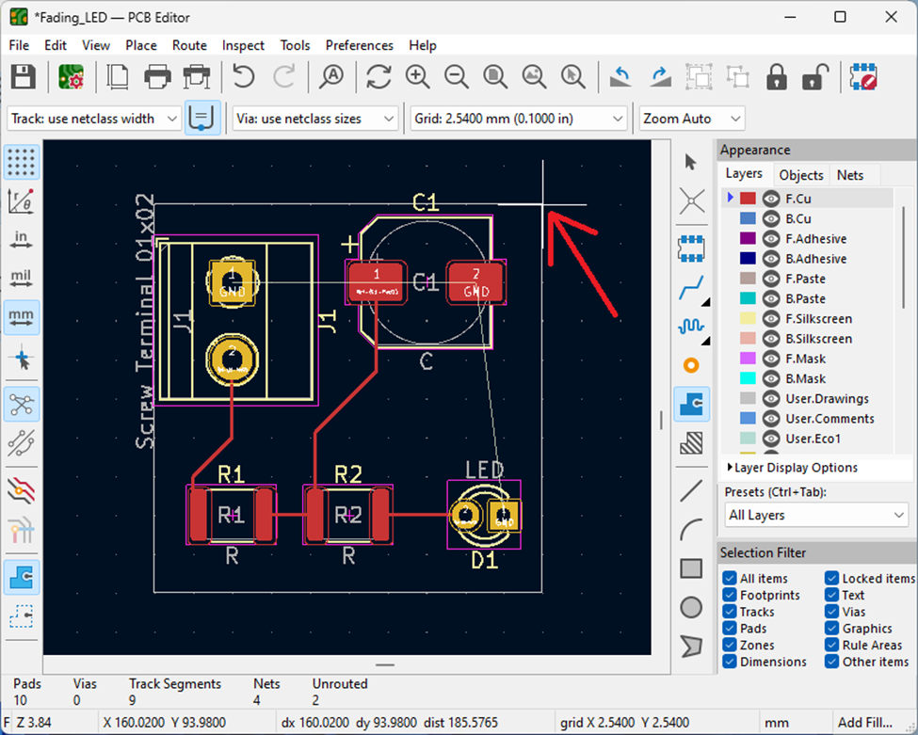
Click a corner of the PCB rectangle.
A dialog window should pop up.

Slide 29
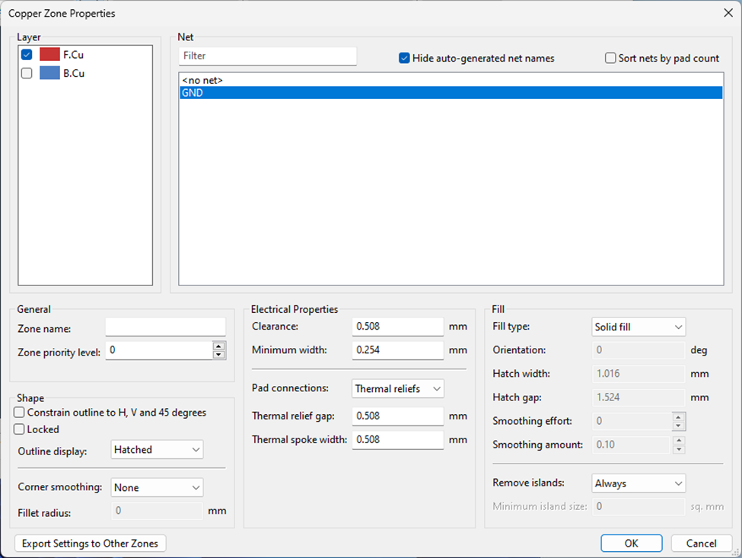
Click on GND and ensure the F.Cu layer is selected.

Slide 30
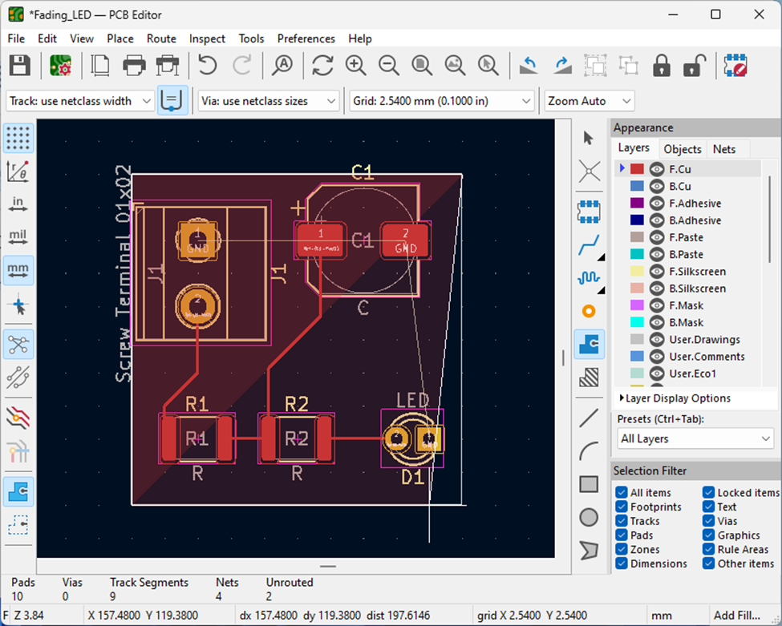
Now, starting from the corner where you clicked initially, you will draw a line to the other corners, returning to the original corner.
This image shows 3 corners selected, partially through the process for additional guidance.

Slide 31
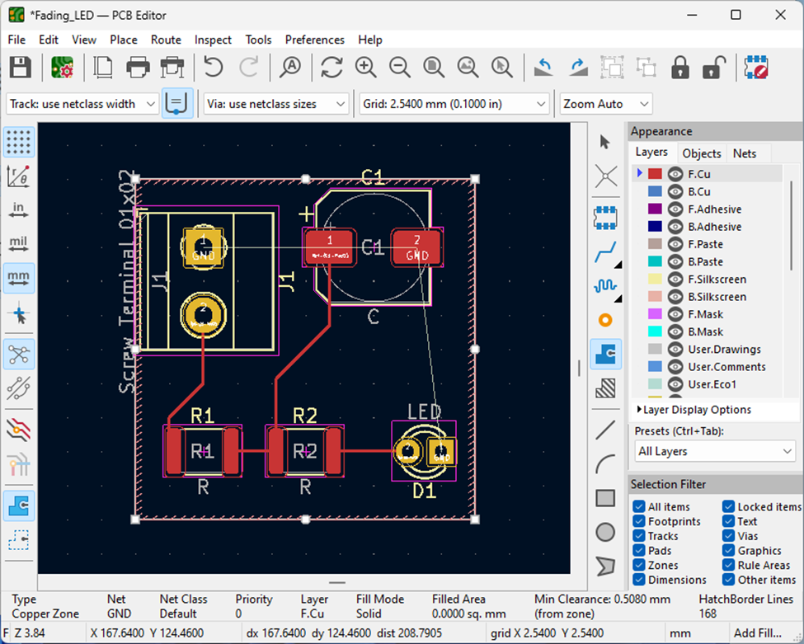
This is what the PCB page will look like once you are done.

Slide 32
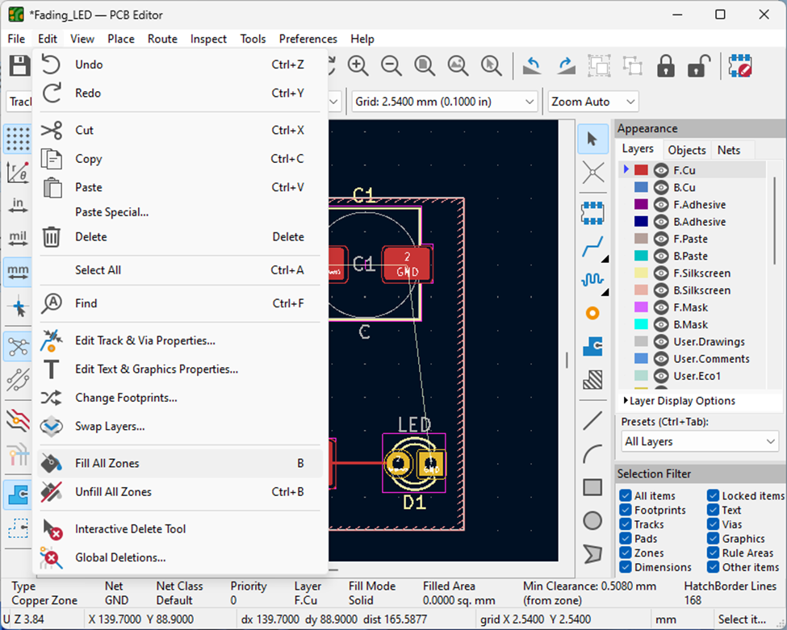
Now, to fill all the zones in, we select the Fill All Zones icon under the ‘Edit’ dropdown menu.

Slide 33
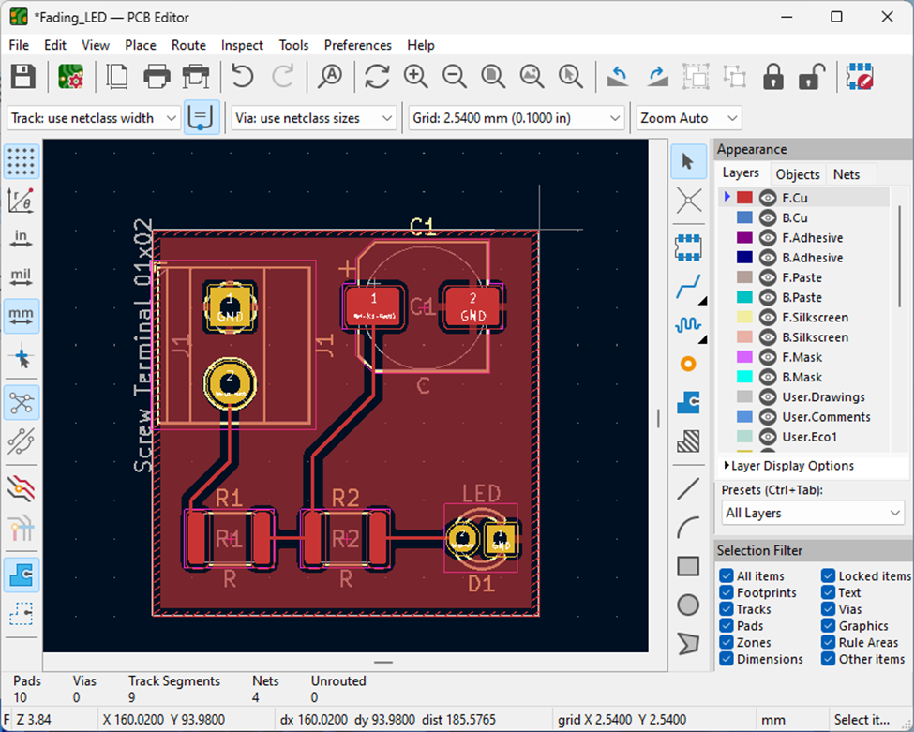
This is what your PCB should look like at this stage.

Slide 34
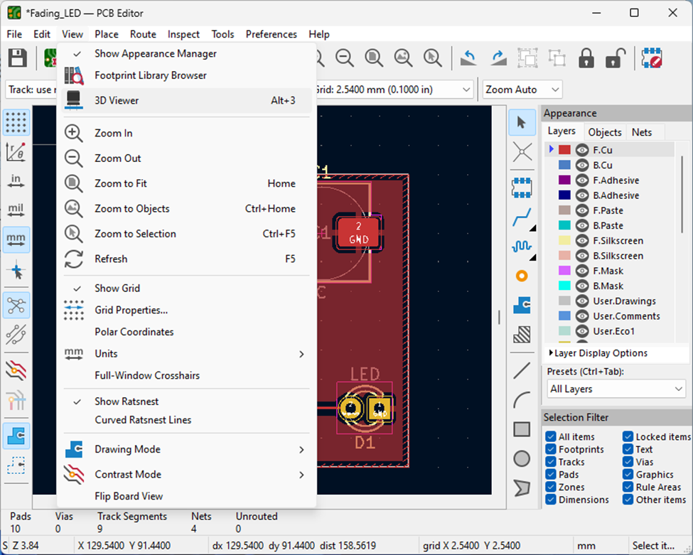
Now, we can view the Finished PCB in 3D.

Slide 35
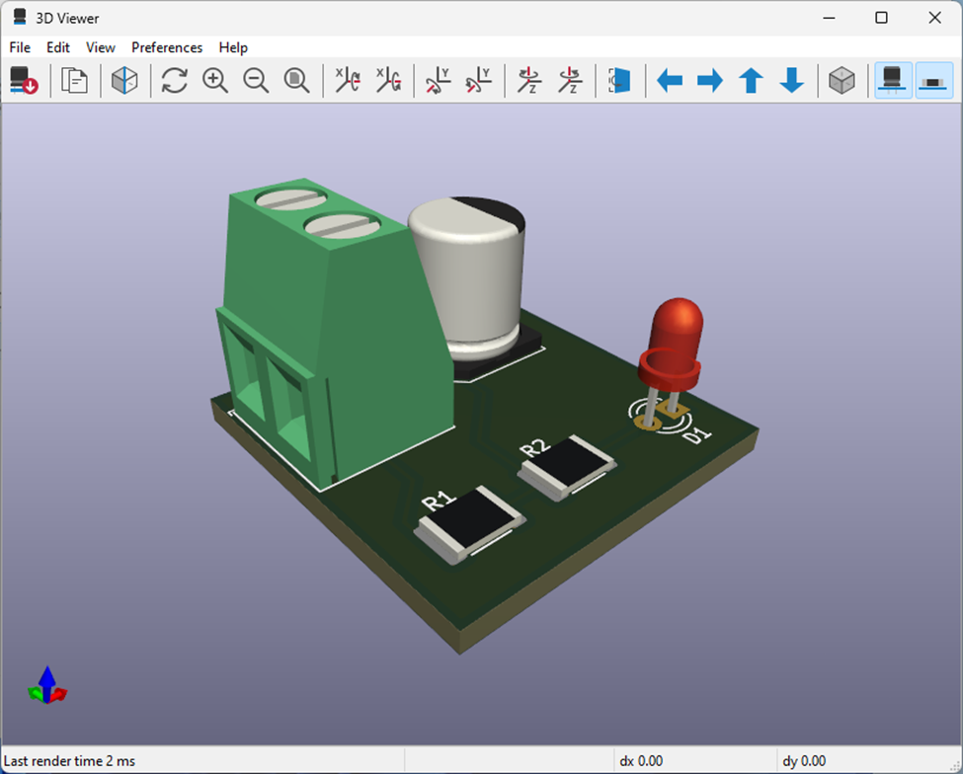
This is the finished product for this lab.
Ask the TA to check you off once you get to this stage.

Slide 36
Notes
For more complex PCBs, the B.Cu layer may also be used
This is done on KiCAD Version 6.0 on Windows 11.
These Instructions are not guaranteed to work on newer version of KiCAD or on MacOS
Author: J.C. Vaught, Spring 2024

